Slide 1
AQA
AS Level
Computer Science
Paper 1
Programming basics
Unit 1
Fundamentals of programming

Slide 2
Objectives
Define what is meant by an algorithm and pseudocode
Learn how and when different data types are used
Learn the basic arithmetic operations available in a typical programming language
Become familiar with basic string handling operations
Distinguish between variables and constants
Write pseudocode solutions to simple problems

Slide 3

Algorithms
An algorithm is a sequence of instructions that can be followed to solve a problem
For example, suppose you want to calculate the amount of paint needed to paint a room

Slide 4

Problem: calculate paint required
What inputs would you need?
What decisions does the painter need to make?
Think out the sequence of instructions, starting with
Input the dimensions of the room
Use statements like
Input, Calculate, Output, Add, Subtract, Multiply
Or maths symbols like +, -, * (multiply)

Slide 5

Worksheet 1
Complete Task 1 of the Worksheet

Slide 6
Pseudocode
Pseudocode is used to write instructions in statements that are somewhere between English and a programming language
There are guidelines for writing pseudocode, but no strict rules
They are an aid to thinking out the steps needed before you start to code
Once you have written the pseudocode, the coding should be a breeze!

Slide 7
Pseudocode statements
Assignment statements can be written using an = sign or a ←
The symbols +, -, *, / , ** (exponentiation) are used for common arithmetic operations
miles ← currentMileage – previousMileage
count ← count + 1
Output and input statement are written
OUTPUT “Enter current mileage”
currentMileage ← USERINPUT
Or, currentMileage ← USERINPUT(“Enter current mileage”)

Slide 8
Pseudocode statements
What do the following statements do?
OUTPUT “Enter a number”
number ←USERINPUT
number ← number + 1
OUTPUT “The number is : ” + number
Notes:
User input is assigned to the variable Name
The message “Enter a number” is displayed on the screen
The variable number is assigned the value typed in on the keyboard
number is incremented by 1
A string “The number is: “ is concatenated with the variable number.

Slide 9
Pseudocode
Compare pseudocode and Visual Basic
What is happening?
What is the advantage of using pseudocode?
number ← 0
OUTPUT “Enter a number”
number ← USERINPUT
IF number > 4 THEN OUTPUT “Greater than 4”
ELSE
OUTPUT “4 or less”
ENDIF
Dim number As Integer = 0
Console.Write("Enter a number")
number = Console.ReadLine()
If number > 4 Then
Console.WriteLine("Greater than 4")
Else
Console.WriteLine("4 or less")
End If
Notes:
A variable number (space in memory to hold data) is declared and assigned an intimal value 0
A message is sent to the screen prompting the user to input a number
User input from the keyboard is read and assigned to the memory location “identified” by the variable name.
A selection statement evaluates the value of number to determine if it is larger than 4.
An appropriate output message is sent to the screen

Slide 10
Pseudocode
What is the purpose of pseudocode?
What guidelines would you suggest for writing clear, understandable pseudocode?
number ← 0
OUTPUT “Enter a number”
number ← USERINPUT
IF number > 4 THEN OUTPUT “Greater than 4”
ELSE
OUTPUT “4 or less”
ENDIF
Notes:
It is used to design an algorithm that solves a problem.
It may also be used to communicate that solution to others.
Use sensible identifiers such as age, height, name rather than a, h, n. This makes it easier for others to read.
Be sure to indent where necessary as in the example above. This makes it easier to read and thus easier to debug.

Slide 11
Variables and assignment
An identifier is a name, e.g. Score, that points to a memory location
Assignment is assigning a value to the memory location
In this example Score is assigned the value of 0
In the next line, 1 is added to Score and the result is again assigned to Score
Start
Score ← 0
Score ← Score + 1
End

Slide 12
Data types
Here are some variable declarations in VISUAL BASIC
What does each line do?
In Python, a variable doesn’t have to be explicitly declared as a particular data type. It happens when you assign data to the variable.
Dim wholeNumber As Integer = 5
Dim height As Decimal = 1.5
Dim name As String = "Bob"
Dim choice As Char = "a"
Dim validData As Boolean = False
Notes:
Declaration of variable wholeNumber as an integer and assignment of the value 5
Declaration of variable height as decimal and assignment of the value 1.5
Declaration of the variable name as a string of characters and assignment of the value “Bob”
Declaration of the variable choice as a character and assignment of the value “a”
Declaration of the variable validData as Boolean and the assignment of the value False.

Slide 13
Data types
What happens if the character “9” is assigned to an integer variable?
What are the allowable values of a Boolean data type?
Dim wholeNumber As Integer = 5
Dim height As Decimal = 1.5
Dim name As String = "Bob"
Dim choice As Char = "a"
Dim validData As Boolean = False
Notes:
When the variable is declared the identifier (variable name) points to a memory location that is assigned in RAM, the size of the memory location will be determined by the variable type. The type of data that is “valid” for the location will be determined by the type. The assignment of a value, if legal, will place the value in the memory location “labelled” by the variable identifier.
height
The identifier is a label that points to the memory location to store the value
This depends on the data type and programming language. VB a char is 2 bytes and an integer is 4 bytes.
This is not allowed and an error message will be displayed.
True and False.

Slide 14
Variables and Constants
The value of a variable can be changed while the program is running
To change the value of a constant, you have to change it in the source code and then recompile
A constant cannot be the target of an assignment
Dim name as String = “Robert”
Const VAT as Single = 17.5
Console.WriteLine(“VAT is: “ & VAT)
Name = “Hazel”
Console.WriteLine(“Name is: “ & name)
VAT = 20 ‘this will cause an error

Slide 15
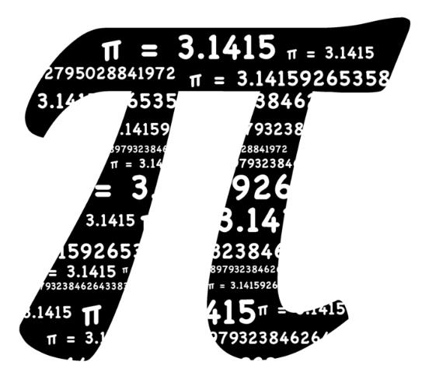
Why use a constant?
Constants reduce the risk of errors by reducing access to the memory location
Would you declare 3.14159265359 as a variable or a constant?

Slide 16
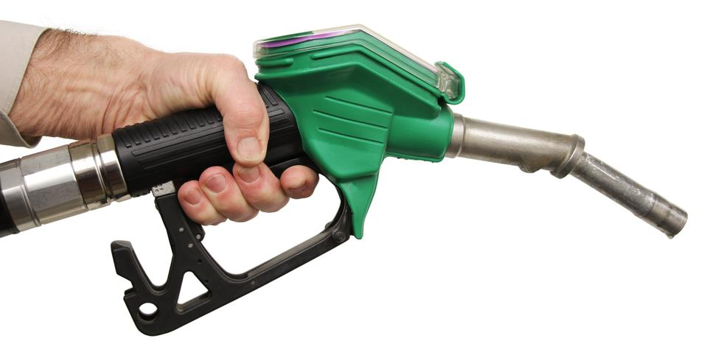
Worksheet 1
Complete the questions in Task 2 of the Worksheet

Slide 17
The mod and div operators
The operator mod is used to find the remainder in integer division
div returns the integer part of the division
x = 17 mod 3 sets x = 2
y = 17 div 3 sets y = 5

Slide 18
The mod and div operators
Calculate the following:
8 mod 8
8 div 8
10 mod 8
10 div 8
Notes:
8 mod 8 = 0
8 div 8 = 1
10 mod 8 = 2
10 div 8 = 1

Slide 19
String handling functions
Programming languages have a number of built-in string handling functions or methods
For example:
name ← “Robert”
x ← len(name)
x ← name.len returns the length of string name
x ← name.find(“be”) determines if “be” occurs in string name
(returns the position of the first character in the string, 0 if not found)

Slide 20
String handling functions
What would the following return? (Assume the index starts at 0)
name ← “John”
x ← len(name)
x ← name.find (“be”)
x ← name.find (“oh”)
Notes:
4
0 “not found”
1 “index of o in John”

Slide 21
String handling
What values will be assigned to the variables?
(A string is indexed from 0)
What type are the variables?
Dim name As String = "Robert"
'Retrieves element 1 and assigns it to letter
letter = name.Substring(1)
'Third element in the name string
thirdChar = name(3)
'Assigns elements 1 to 3 in name to answer
answer1 = name.Substring(1,3)
'Determines if start of string matches the search string answer2 = name.StartsWith("Ro")
answer3 = name.StartsWith("Jo")
Notes:
o
e
obe
True
False

Slide 22

Worksheet 1
Now try the questions in Task 3 of the worksheet

